Slide 1

Coffee Quality Data Analysis Milestone – 1 (Python Data exploration project)
Student Name: Praveen Kumar N
Course: DA/DS
Date:24.07.2024

Slide 2

Introduction
The objective of this project to conduct a comprehensive data exploration, cleaning, and analysis to derive a comprehensive data exploration, cleaning and analysis to derive meaningful insights from the dataset.
Importance of data understanding, preprocessing and visualization in data analytics project :
1)Data Understanding :
Contextualization, Identifying Limitations and Feature selection.
2)Data preprocessing:
Data Quality, and Normalization and Feature Engineering.
3)Visualization:
Insight Generation, Communication and Decision Making.

Slide 3
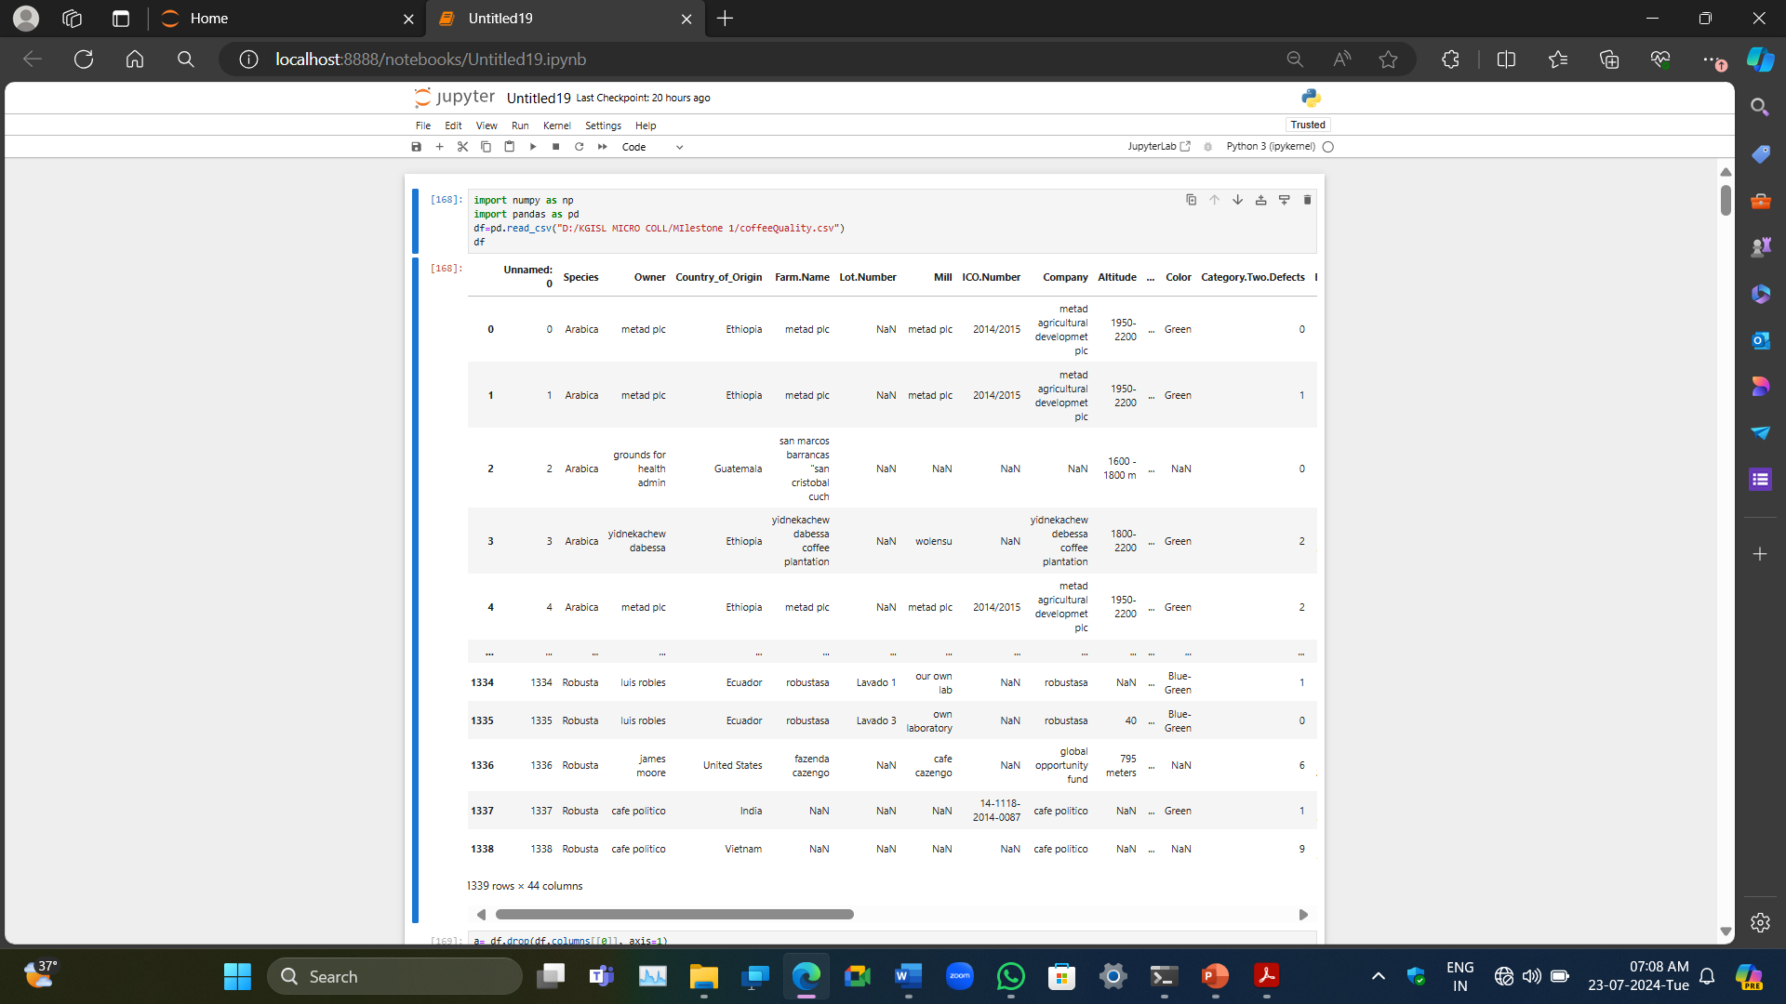
Data Understanding The Data set initially consisted of 1339 rows and 44 columns :;

Slide 4
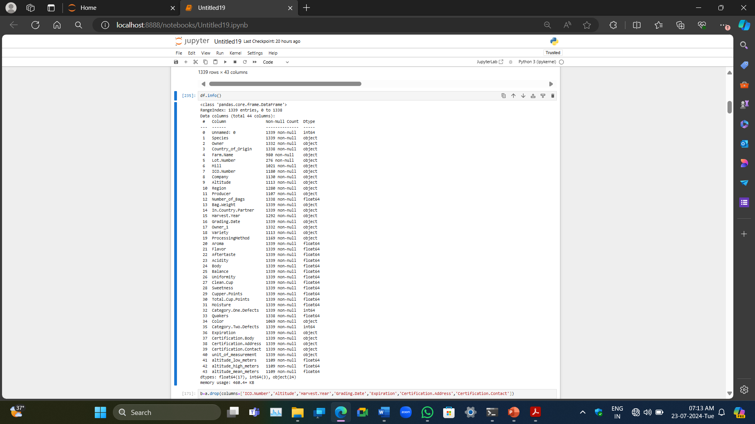
Data Understanding
In the Data set of 1339 rows and 44 columns we have :
24 were object 17 were float 3 were integer In it

Slide 5
Initial Exploration
When we check the original dataset, we find a large number of missing values and numbers
that are useless for our further research because they don't indicate how the coffee's quality
is impacted. Using a boxplot will allow us to see every outlier that needs to be eliminated.

Slide 6
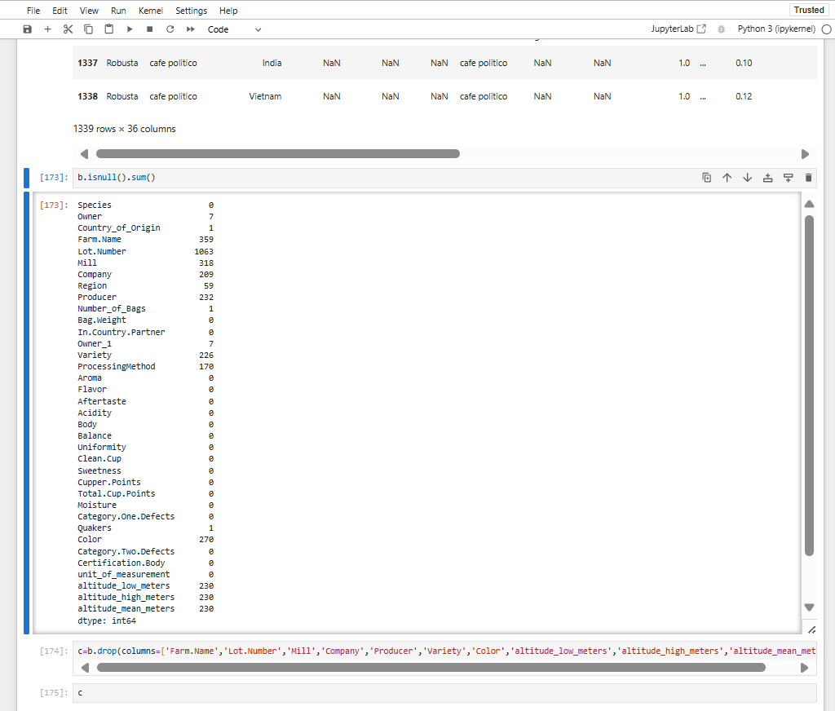
Missing Values Handling
Missing values must be treated cautiously. After eliminating all unnecessary columns,
we use "isnull().sum()" to find the number of missing inputs in the dataset. We now search for all missing data to see if they exceed 15%. Every value with more than 15% of missing values must be eliminated. Next, we take all of the columns that have missing values and apply the proper techniques (mean, median, and mode).

Slide 7
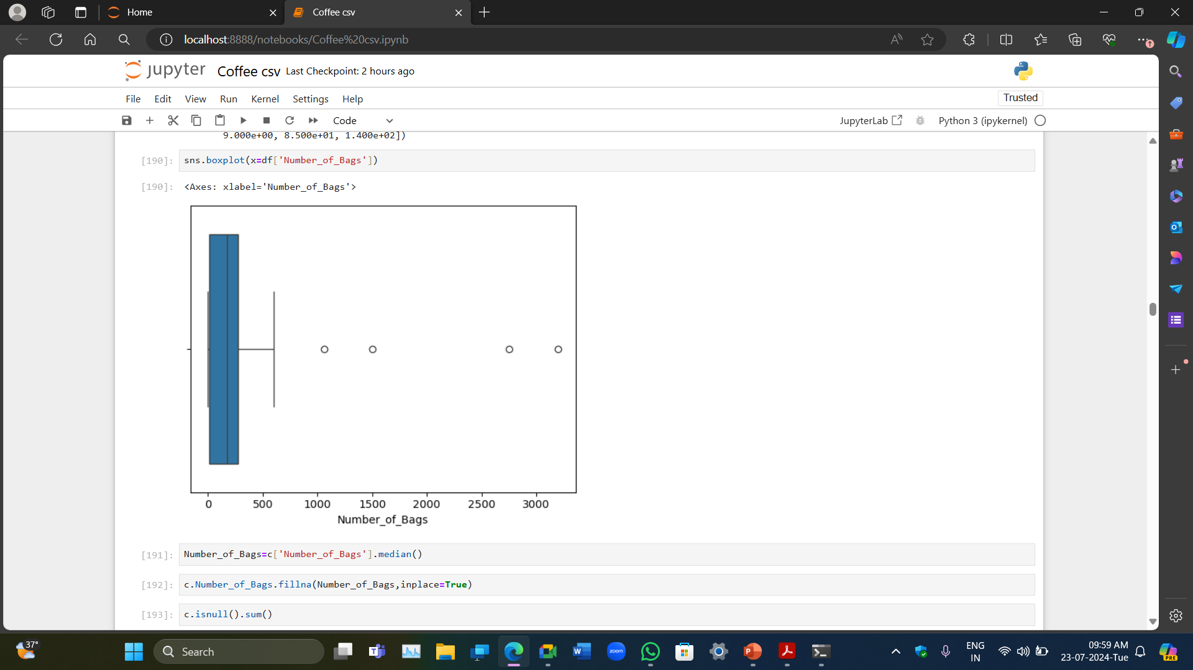
Outlier Handling
The goal is to identify and manage extreme values that deviate significantly from the norm. Boxplot was done to see if there are outliers present in the datasets for some values. Now, to remove all of them, we use the IQR method. A different data frame is used to remove the categorical values. The Q1 and Q3 are checked using.quantile(0.25) and.quantile(0.75) The interval between the third and first quarters. Then, df<(Q1-1.5*IQR)The outliers would come from df>(Q3+1.5*IQR) Any values at the extreme ends that are not in line with the average values, if we include them, we get skewed values if we don't remove them.
Now after getting the outliers and saving it in a variable we can use the NOT Operator to just remove these outliers from our original data frame
This is boxplot of number of bags , a numerical value which shows us the presence of outliers
Before-1339 rows * 26 columns
After-592 rows*26 columns

Slide 8
Invalid Values
Datasets would contain some values that are invalid which we cannot utilize nor is it beneficial in our data analysis. are referred to as illicit values. We need to pinpoint these principles and eliminate them so they do not interfere with our analysis. These may include many varieties such as categorical columns consisting only of a single value, copious amount of missing values, etc.
Some of these values we eliminated encompassed, elevation values which had no meaningful impact on it(also had more than 15% of missing values), Owner.1, which had no importance, etc.

Slide 9
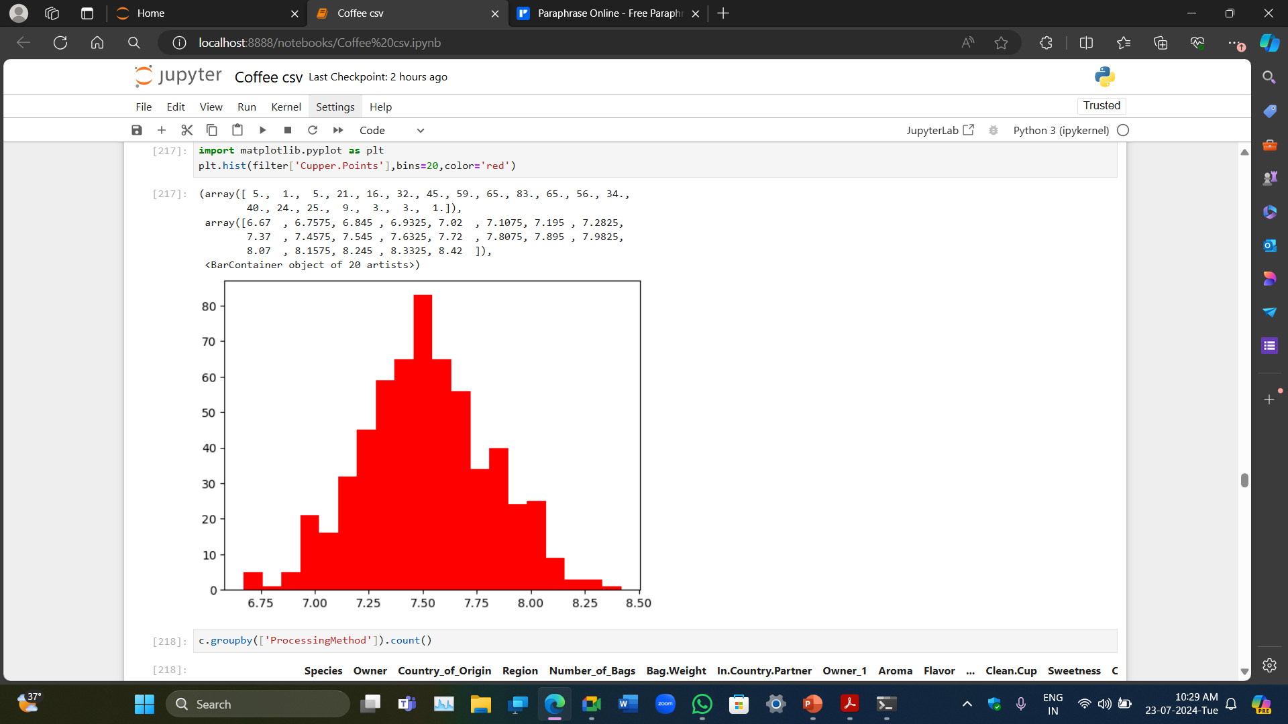
EDA
Histogram of cupper points
Key insights
Cupper points & flavor is the most dependable values to Total cup points.
Therefore , Flavor & cupper points plays a major role in quality.
There is no value that is highly negatively correlated to total cup points.
Moisture shows a moderately negative correlation

Slide 10
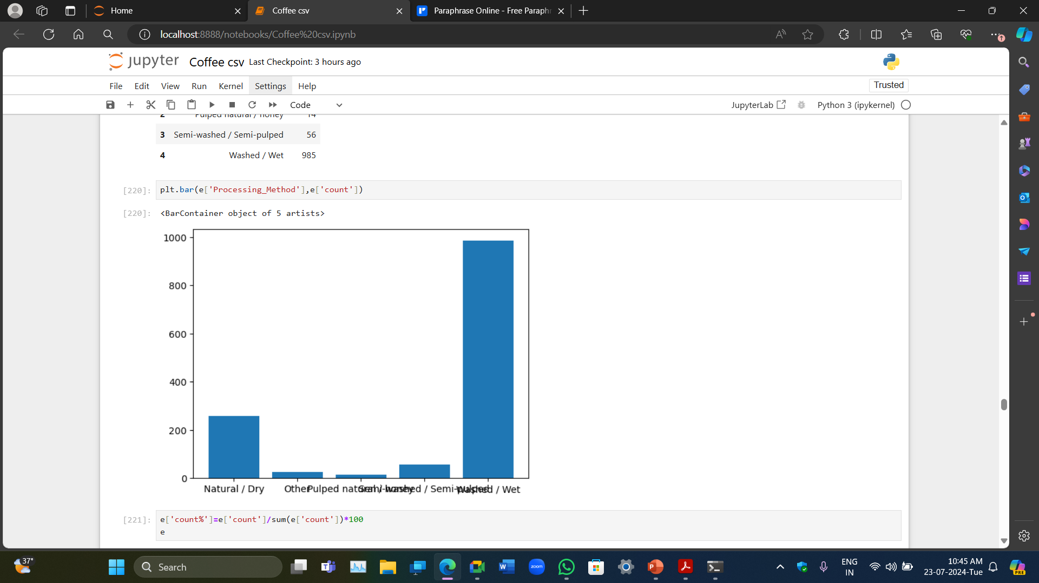
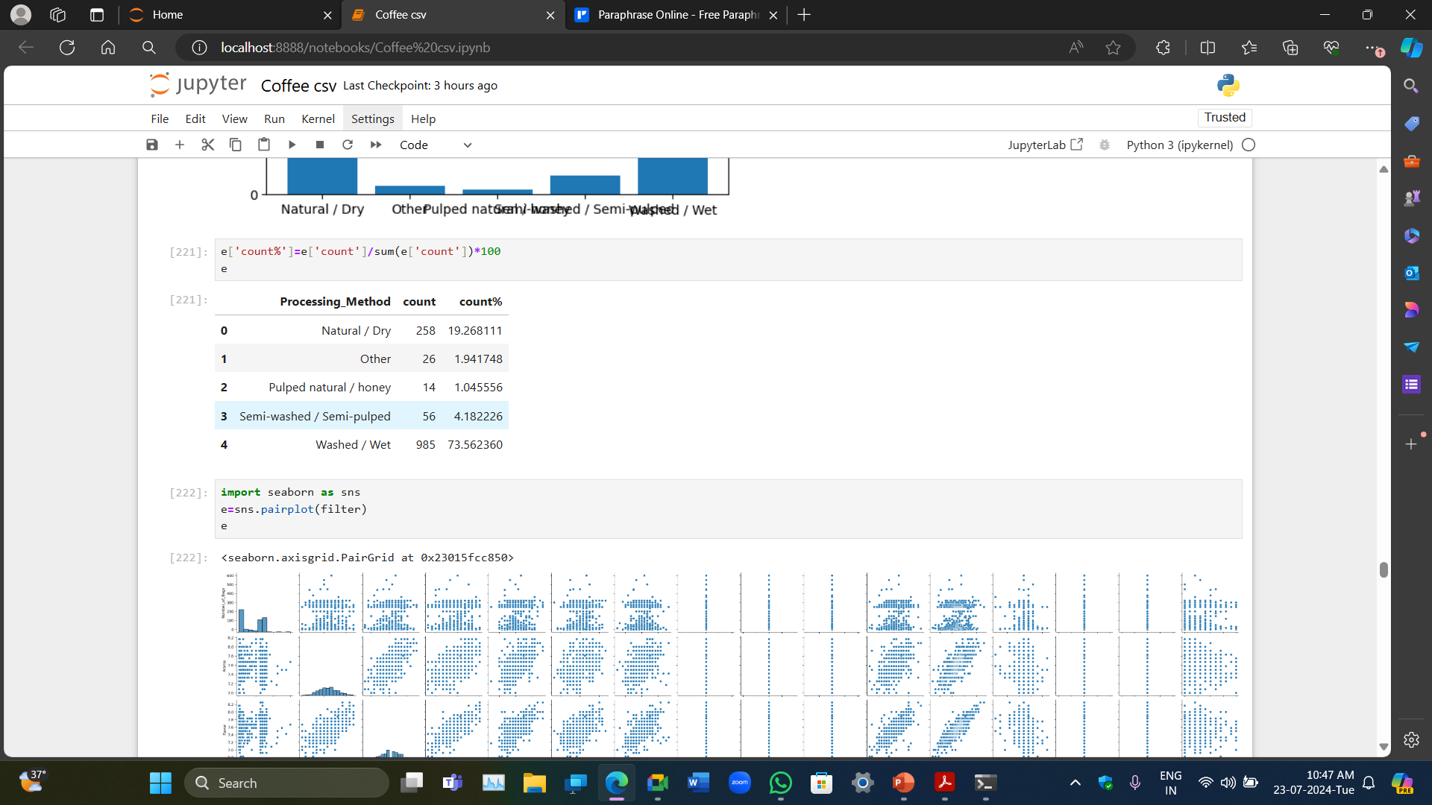
Bar graph of Processing method
Showing that out of the 5 Processing method
Natural/day 19.2%
Pulped natural/honey 1.04%
Semi-washed/semi-pulped 4.182%
Washed/Wet 73%
Other 1.94%

Slide 11
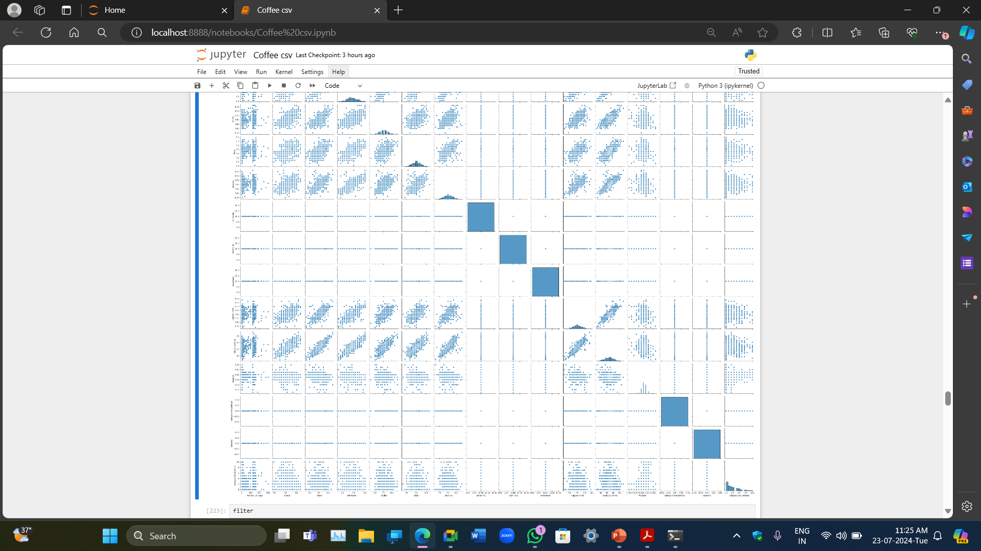
A pair plot is a useful graph that gives an entire overview of the correlations of the data

Slide 12
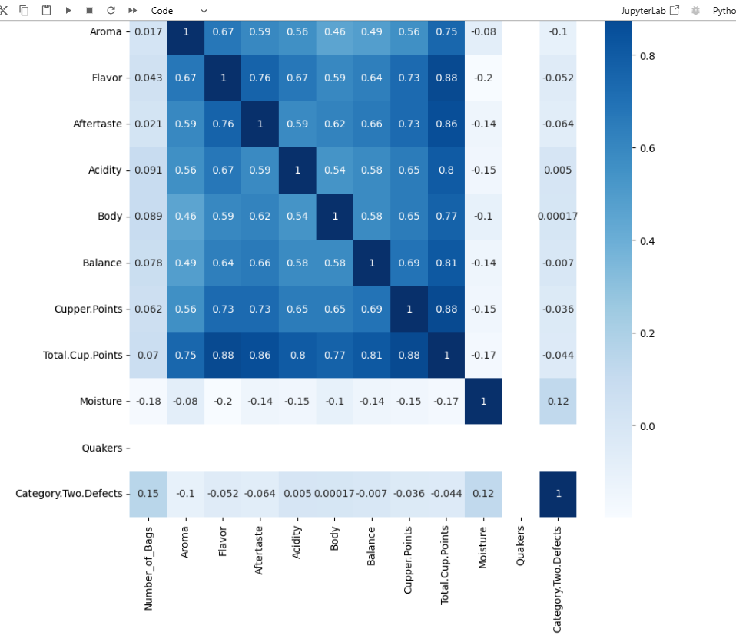
From this we can see that cupper points & flavor is the most positively correlated with the total cup points. Heatmap is useful for this as we can identify the correlation based on the color so it is easier

Slide 13
Upward climbing straight line shows highly positive correlation
Correlation between cupper point and total cup points
Correlation between flavor and total cup points

Slide 14
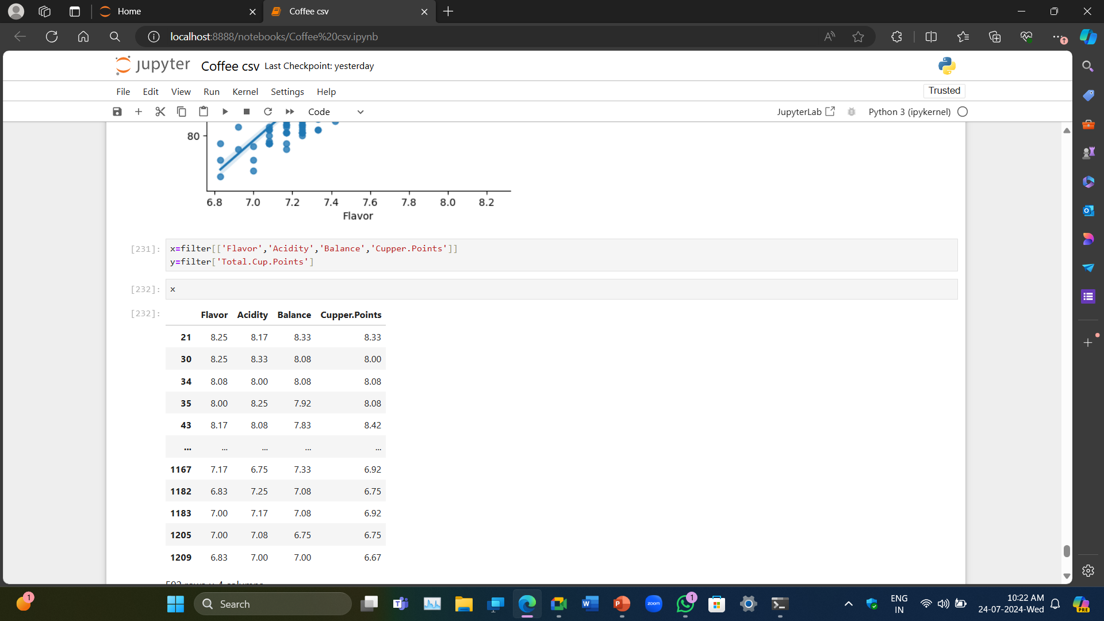
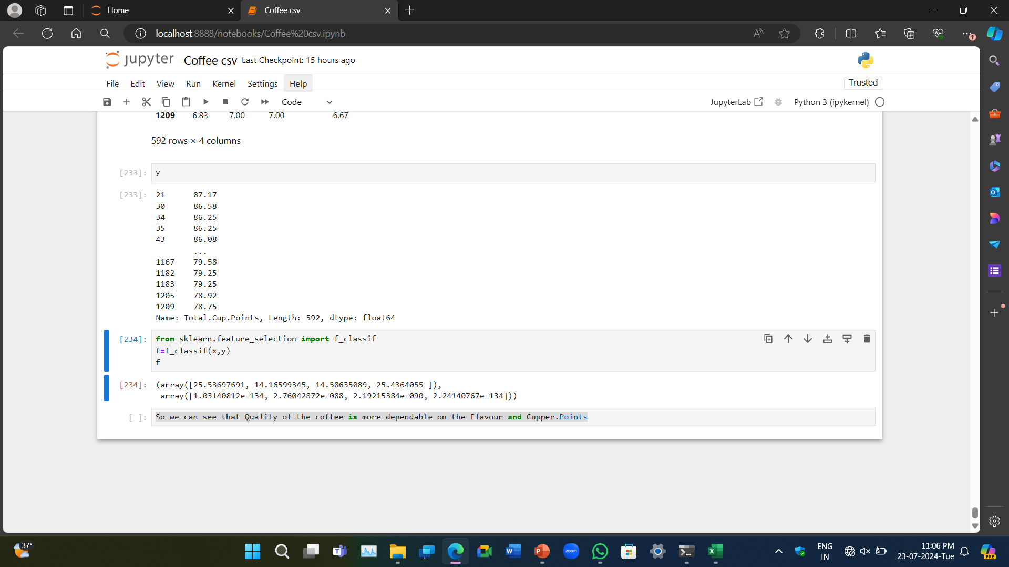
Since first & last column is the closest to 0 we can say that these are the columns most dependable on total cup points
The columns are none other than flavor & cupper points

